Slide 1


Medical Inventory Optimization

Slide 2
Contents
Business Objective
Business Constraints
Project Architecture
Data Collection
Exploratory Data Analysis
Data Visualization
Notes:
Change

Slide 3
Project Overview and Scope
Customer: A leading Hospital in India
Business Problem: Bounce rate is increasing significantly leading to patient dissatisfaction
Business objective: Minimize the bounce rate
Business Constraint: Minimize the inventory cost
Business Success Criteria: Reduce bounce rate by atleast 30%
Economic Success Criteria: Increase Revenue by atleast 20 LAC INR

Slide 4
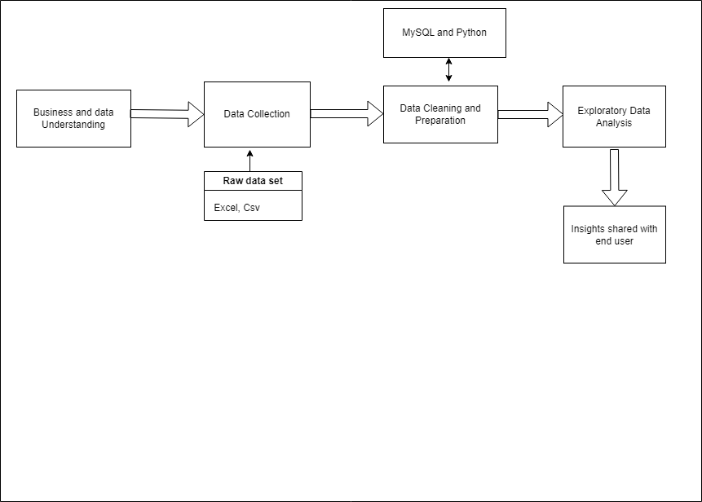
Project Architecture
Notes:
Change

Slide 5
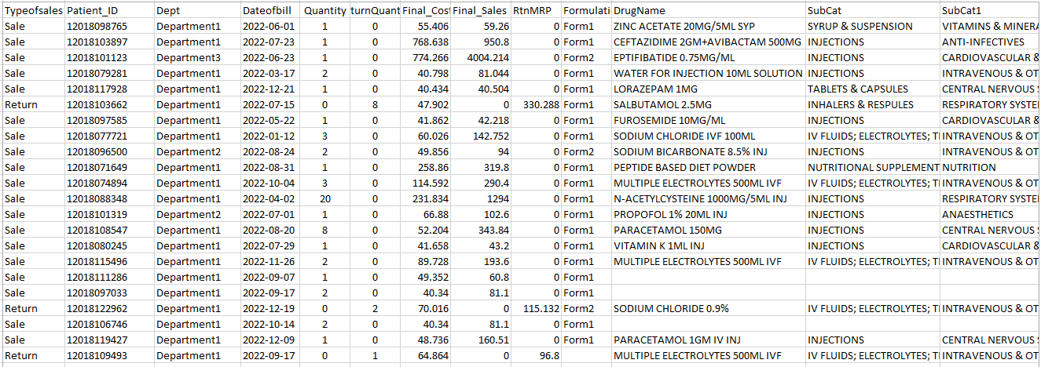
Data Collection
Data is extracted from the public sources and then client provided data is mapped. Finally one master data is shared for further analysis, which contain 14,218 rows and 14 columns
Notes:
Change

Slide 6
Data Dictionary
VARIABLE NAME | VARIABLE DESCRIPTION
Typeofsales | Type of sale of the drug. Either the drug is sold or returned.
Patient_ID | ID of a patient
Specialisation | Name of Specialisation (eg. Cardiology)
Dept | Pharmacy, the formulation is related with.
Dateofbill | Date of purchase of medicine
Quantity | Quantity of the drug
ReturnQuantity | Quantity of drug returned by patient to the pharmacy
Final_Cost | Final Cost of the drug (Quantity included)
Final_Sales | Final sales of drug
RtnMRP | MRP of returned drug (Quantity included)
Formulation | Type of formulation
DrugName | Generic name of the drug
SubCat | Subcategory (Type) to the category of drugs.
SubCat1 | Subcategory (condition) to the category of drugs

Slide 7
Data Preprocessing
Data type conversion
Handle Missing Values
Removing Duplicates
Handling Outliers- Industry Capping Method
Notes:
Keep observations

Slide 8
Exploratory Data Analysis
Calculating the first moment business decision(Measures of central tendency such as mean, median, mode) for the data set
Calculating the second moment business decision(Measures of dispersion, standard deviation, range) for the data set
Calculating the third moment business decision(skewness) for the dataset
Graphical representation
Calculating the first moment business decision (Kurtosis) for the dataset
Notes:
Change

Slide 9
Exploratory Data Analysis [EDA]
Statistical Insights
Business Insights
First moment business Decision: Measure of central tendency
On average the quantity of medicine sold per transaction is 1.78 units.
Average medicine sold per transaction is around $88.47.
Average sales revenue generated per transaction is $165.01.
Return value of medicine based on manufactures' retail price is around $13.85.
Median Quantity 1 shows that 50% of transactions involve purchasing just 1 unit of drug.
Mode of data is with final_cost of $49.352.
The variance of 3.32 suggests a moderate amount of variability in the quantity of items sold.
The high variance of 17736 in final cost indicates significant variability in the cost of items in your inventory.
The extremely high variance of 71134 in final sales suggests substantial variability in the revenue generated from different transactions.
Attribute | Mean | Median | Mode
Quantity | 1.78 | 1 | 1
Final_Cost | 88.47 | 52.99 | 49.352
Final_Sales | 165.01 | 56.44 | 60.8
RtnMPR | 13.85 | 0 | 0
Second moment business Decision: Measure of Dispersion
Attribute | Variance | Standard Deviation
Quantity | 3.32 | 1.82
Final_Cost | 17736.69 | 133.18
Final_Sales | 71134.19 | 266.71
RtnMPR | 2596.22 | 49.96
Notes:
EDA is used for seeing what the data can tell us before the modeling task.
Change

Slide 10
Exploratory Data Analysis [EDA]
Business Insights
A positive skewness of 2.91 in quantity suggests that the distribution is skewed to the right. This means that there may be a few transactions with significantly higher quantities than the majority of transactions.
A positive skewness of 5.86 in final cost suggests a right-skewed distribution. This indicates that there may be a few items with much higher costs than the majority of items.
A positive skewness of 4.3 in final sales indicates a right-skewed distribution. This suggests that there may be a few transactions with much higher sales amounts than the majority of transactions.
A high positive kurtosis of 14.7 in quantity suggests a distribution with heavy tails and a very sharp peak. This indicates that there are extreme values (outliers) in the distribution, and the data has more values in the tails than a normal distribution.
Final_sales kurtosis 24.76 indicates that there are transactions with exceptionally high sales amounts compared to the majority of transactions.
A very high positive kurtosis of 41.6 in final cost indicates an extremely heavy-tailed distribution with a sharp peak.
Statistical Insights
Attribute
Quantity | 2.91
Final_Cost | 5.86
Final_Sales | 4.3
RtnMPR | 11
4 th Moment business Decision: Measure of Kurtosis
Attribute
Quantity | 14.7
Final_Cost | 41.6
Final_Sales | 24.76
RtnMPR | 35.42
Notes:
EDA is used for seeing what the data can tell us before the modeling task.
Change

Slide 11
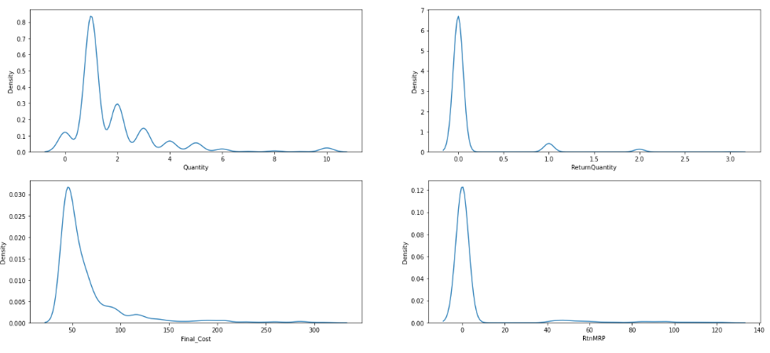
Data Visualization
Notes:
Add graphical

Slide 12
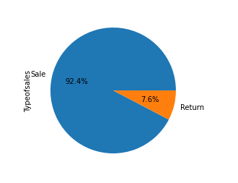
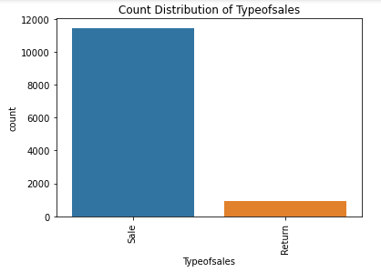
Data Visualization
According to dataset Bounce rate of approximately 8.9% suggests significant customer dissatisfaction due to not receiving needed medicines.
Notes:
Add graphical

Slide 13
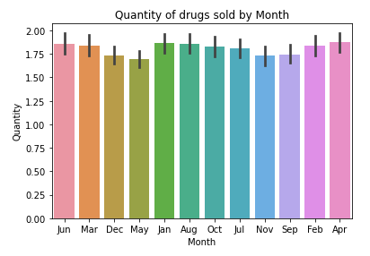
Data Visualization
The month of Jun, March, April, July ,oct ,aug and jan has highest quantity of medicines sold and it is approximately same.
Notes:
Add graphical

Slide 14
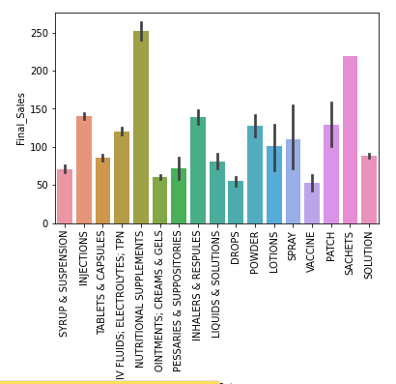
Data Visualization
Subcategory Nutritional supplements indicates higher sales cost which contribute higher revenue through sales.
Notes:
Add graphical

Slide 15
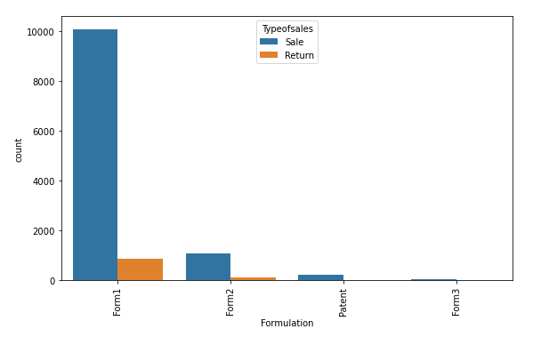
Data Visualization
"Formulation 1" has the highest number of return transactions (return type transactions), it provides insights into the performance and potential issues related to that specific formulation.
Notes:
Add graphical

Slide 16
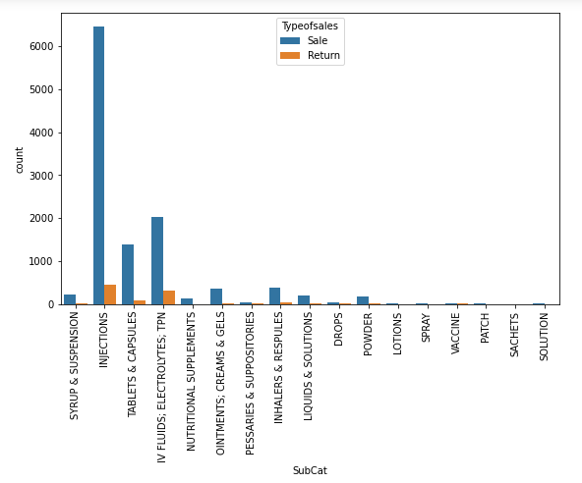
Data Visualization
Subcategory injection is highest number of return transaction. A high number of both return-type and sales-type transactions may indicate that injections are a commonly used or prescribed product.
Notes:
Add graphical

Slide 17
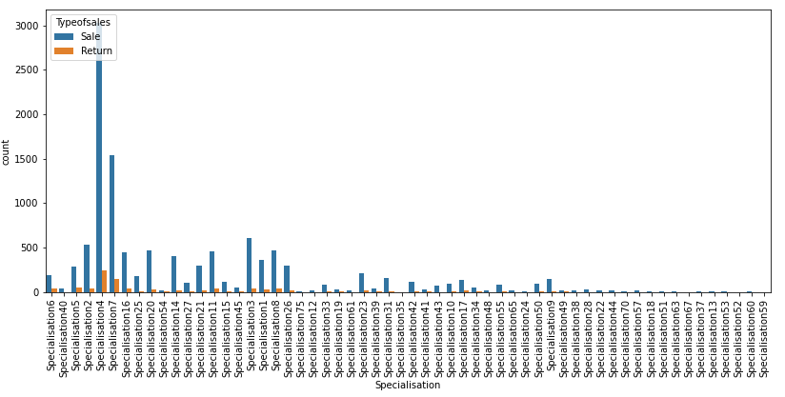
Data Visualization
Specialisation4 and Specialisation7 within Department1 have a higher number of returns compared to other specializations, related to "Form1" formulation.
Notes:
Add graphical

Slide 18
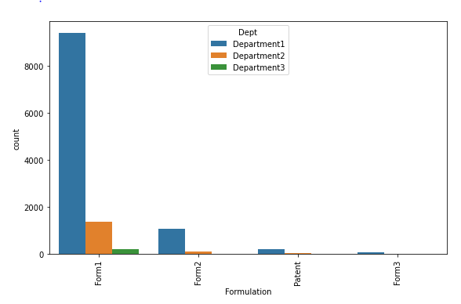
Data Visualization
Form1 is prevalent in Department1 compared to other departments, potentially contributing to the higher return rate.
Notes:
Add graphical

Slide 19
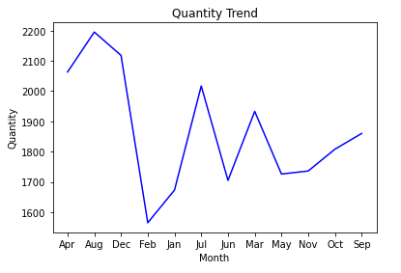
Data Visualization
Total quantity of items sold per month based on the 'Month' column. we can clearly see here aug ,jul and march has highest sales as compared to other month.
The overall direction of the line (upward or downward) provides insights into the general trend of sales over time. An upward trend suggests sales growth, while a downward trend indicates a decline.
Notes:
Add graphical

Slide 20
Insights
Unclean data shows higher mean, variance, standard deviation, range, skewness, and kurtosis values.
Cleaning resulted in more stable and reliable data for decision-making.
Bounce rate of approximately 8.9% suggests significant customer dissatisfaction due to not receiving needed medicines.
"INJECTIONS" subcategory has the highest count of returned drug names.
"Form1" formulation has the highest return count within "INJECTIONS“ making it a focus area for improvements.
"Form1" is prevalent in Department1 compared to other departments, potentially contributing to the higher return rate.
Specialisation4 and Specialisation7 within Department1 have a higher number of returns compared to other specializations, related to "Form1" formulation.
The hospital experiences varying needs and demands during different seasons
Notes:
Add graphical

Slide 21


